Slide 1
Operations as a Competitive Weapon
Recommended book: Lee J. Krajewski, Larry P. Ritzman, Pearson, 2019

Slide 2
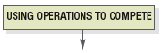
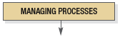
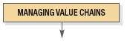
How Operations As a Competitive Weapon fits the Operations Management Philosophy
Operations As a Competitive
Weapon
Operations Strategy
Project Management
Process Strategy
Process Analysis
Process Performance and Quality
Constraint Management
Process Layout
Lean Systems
Supply Chain Strategy
Location
Inventory Management
Forecasting
Sales and Operations Planning
Resource Planning
Scheduling

Slide 3
Operations Management is…
“The systematic design and control of processes that transform inputs into services and products for internal, as well as external, customers.”
Transformation Processes (Adding value)
Inputs
Outputs

Slide 4
Operations Management
An operations system is defined as one in which
several activities are performed
to transform a set of inputs into useful output
using a transformation process
Operations Management is
a systematic approach to
address all the issues pertaining to
the transformation process that converts some inputs into output that are useful, and
could fetch revenue to the operations system

Slide 5
Operations Management as a Function
Functions
Types of Organizations
• Accounting
• Distribution
• Engineering
• Operations
• Finance
• Human
resources
• Marketing
Bank
Construction
Government
Health care
Manufacturing
Retailing
Transportation
Wholesaling
• -----------------
• -----------------
• -----------------
• -----------------
• -----------------
• -----------------
• -----------------
• -----------------

Slide 6
Processes
Processes should add value.
Processes can be broken down into sub-processes, which in turn can be broken down further.
Any process that is part of a larger process is considered a “nested process.”
Each process and each nested process has inputs and outputs.

Slide 7
Process View of an Ad Agency
Accounting process
Advertisement design and planning process
Create the ad to the needs of the client and prepare a plan for media exposure
Output interface process
Communicate with client, get needs, and coordinate progress
Inputs
Outputs
Production process
Prepare ad for publication and deliver to media outlets

Slide 8
External vs. Internal Customers
External Customers are those who purchase the goods and services.
Internal Customers are those who receive the output of others within the firm. They are part of the transformation process.
Inputs from other processes
Outputs to Internal or to External customers
Transformation Processes (Adding value)

Slide 9
Service Processes and Manufacturing Processes
Manufacturing processes change materials in one or more of the following dimensions:
Physical properties
Shape
Fixed dimensions
Surface finish
Joining parts and materials
If a process isn’t doing at least one of these, then it is a service (non-manufacturing) process.

Slide 10
Manufacturing & Service
Manufacturing Organizations | Service Organizations
Physical durable product | Intangible, perishable product
Output can be inventoried | Output can’t be inventoried
Low customer contact | High customer contact
Long response time | Short response time
Regional, national, Intl. markets | Mostly local markets
Large facilities | Small facilities
Capital intensive | Labour intensive
Quality easily measured | Quality hard to measure
Similarities
Is concerned about quality, productivity & timely response to its customers
Must make choices about capacity, location, layout
Has suppliers to deal with
Has to plan its operations, schedules and resources
Balance capacity with demand by a careful choice of resources
Has to make an estimate of demand
Most firms provide both goods and services.

Slide 11
Value Chains
Value chains are an interrelated series of processes that produce a service or product to the satisfaction of customers.
Value chains may have core processes or support processes.
Core processes deliver value to external customers.
Support processes provide vital inputs for the core processes.

Slide 12
Core Processes
Customer relationship processes
Identify, attract, and build relationships with external customers and facilitate the placement of orders.
New service/product development processes
Design and develop new services or products from inputs received from external customer specifications.
Order fulfillment processes
The activities required to produce and deliver the service or product to the external customers.
Supplier relationship processes
Select suppliers of services, materials and information and facilitate the timely and efficient flow of these items into the firm.

Slide 13
Support Processes Internal Value-Chain Linkages
Firms have many processes that support the core processes.
Support processes
New service/ product development process
Customer relationship process
External suppliers
External customers
Supplier relationship process
Order fulfillment process

Slide 14
Operations as a Set of Decisions
Basic Decision-making Steps
Recognize and clearly define the problem.
Collect the information needed to analyze possible alternatives.
Choose the most attractive alternative.
Implement the chosen alternative.

Slide 15
Operations as a Set of Decisions
Strategic Decisions
Tactical Decisions
Development of new capabilities
Maintenance of existing capabilities
Design of new processes
Development and organization of value chains
Key performance measures
Process improvement and performance measures
Management and planning of projects
Generation of production and staffing plans
Inventory management
Resource scheduling

Slide 16
Productivity
Productivity is the value of outputs (services and products) produced, divided by the value of input resources(wages, costs of equipment, etc.)
Output
Productivity =
Input

Slide 17
Productivity Calculation Example 1.1
Single factor
Three employees process 600 insurance policies in a week. They work 8 hours per day, 5 days per week. Calculate the productivity in policies per hour.
Policies Processed
Employee Hours
Labor productivity =
600 Policies
(3 Employees) (40 hours/employee)
=
= 5 policies/hr

Slide 18
Productivity Calculation Example 1.1 continued
Multi-factor
A team of workers makes 400 units of a product,
valued by its standard cost of $10 each (before
markups for other expenses and profit). The
accounting department reports that the actual costs
are $400 for labor, $1,000 for materials, and $300 for
overhead. Calculate the productivity.
Quality at standard cost
Labor cost + Materials Cost + Overhead cost
Multifactor productivity =
(400 units) ($10/unit)
$400 + $1000 + $300
$4,000
1,700
=
=
= 2.35
These figures must be compared with performance levels in prior periods and with future goals.

Slide 19
Homework
Recommended book: Lee J. Krajewski, Larry P. Ritzman, Pearson, 2019

Slide 20
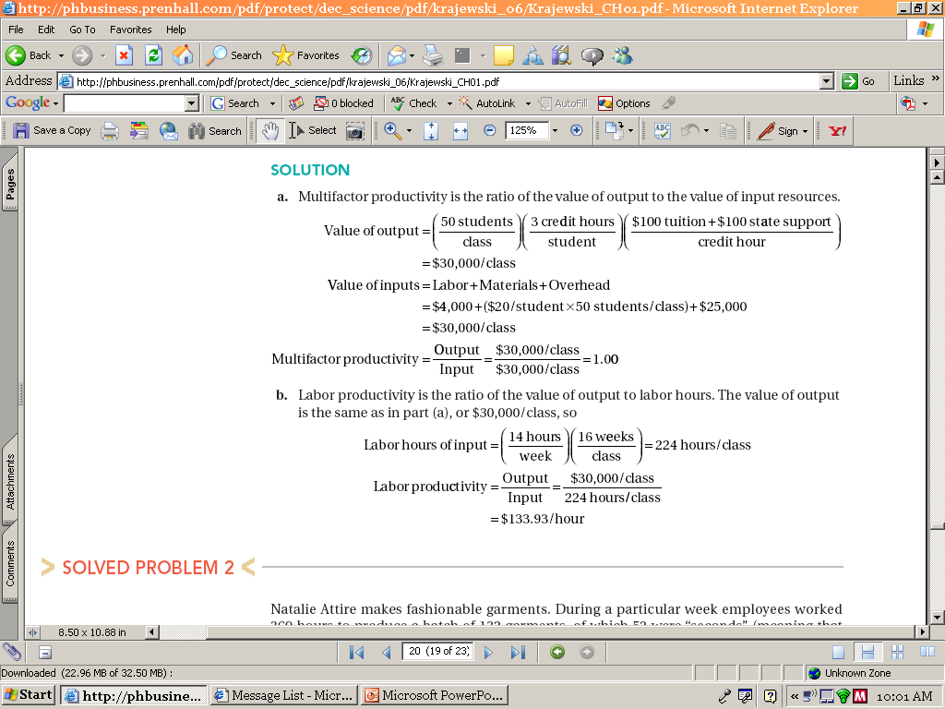
Solved Problem 1
Multifactor productivity is the ratio of the value of output to the value of input resources

Slide 21
Solved Problem 1
b. Labor productivity is the ratio of the value of output to labor hours:

Slide 22
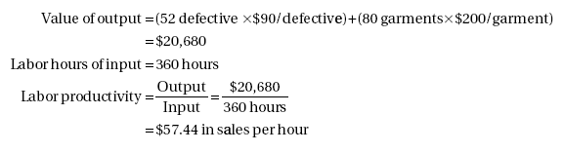
Solved Problem 2

Slide 23
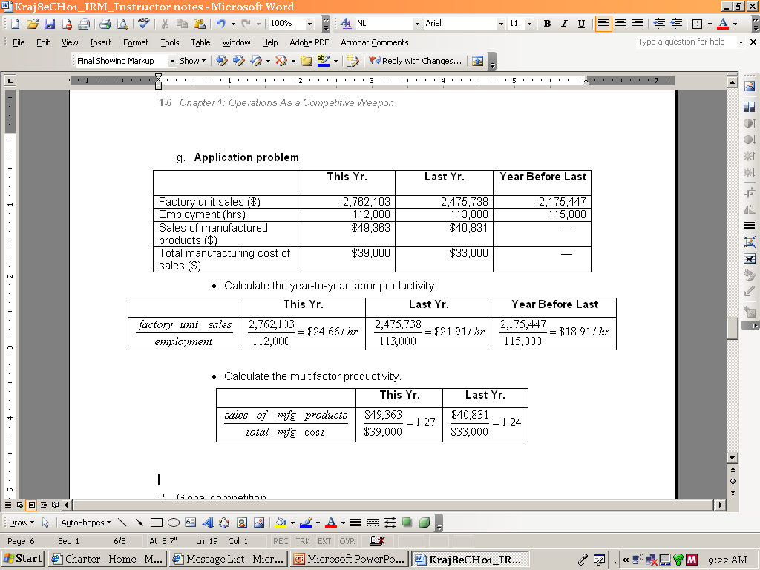
Application
Calculate the year-to-date labor productivity:
Calculate the multifactor productivity:

